Slide 1
MCU TNC Deliverable 5
David Cain, Kobe Keopraseuth, and Kaleb Leon

Slide 2
Testing Tree Progress

Slide 3
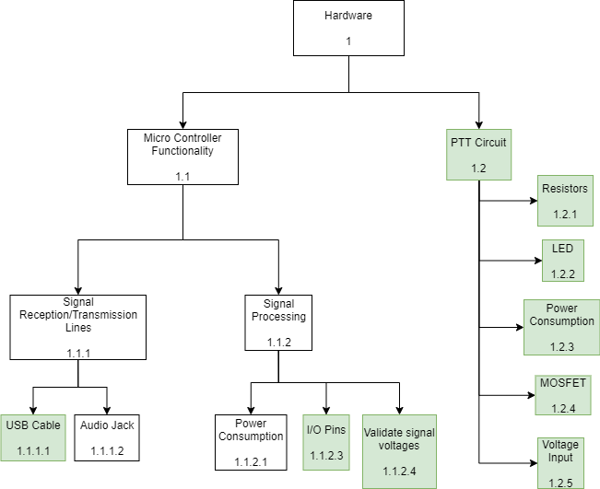
Hardware

Slide 4
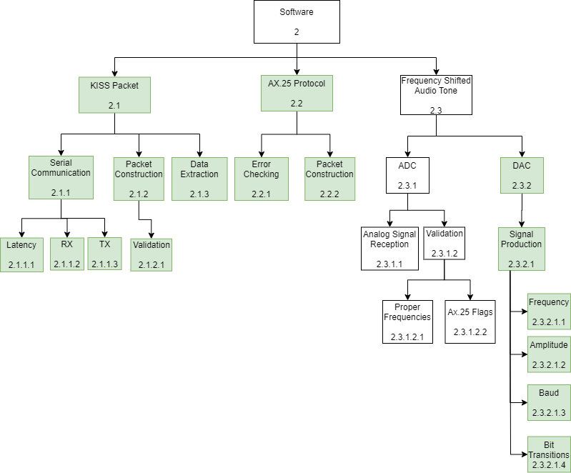
Software

Slide 5
Testing Forms

Slide 6
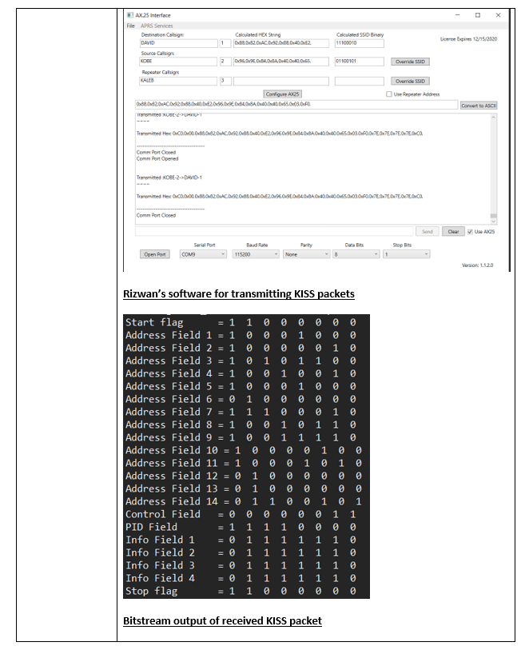

Slide 7
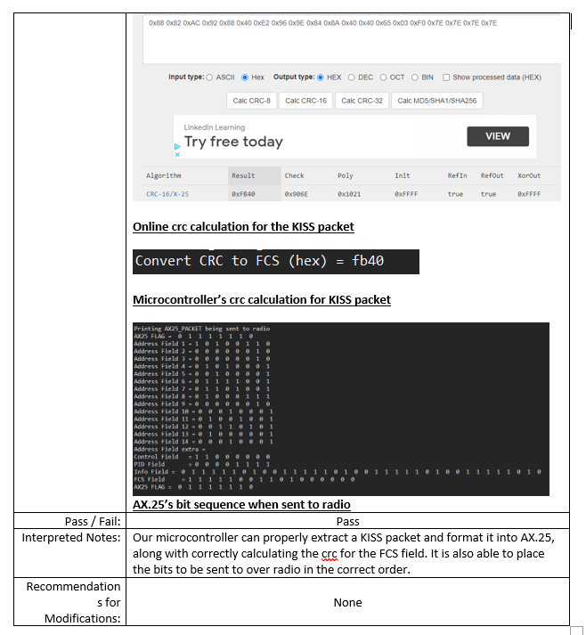

Slide 8
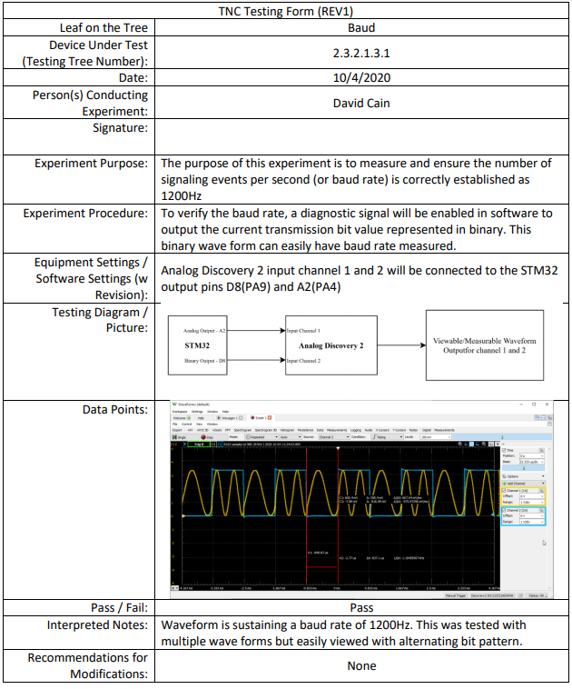

Slide 9
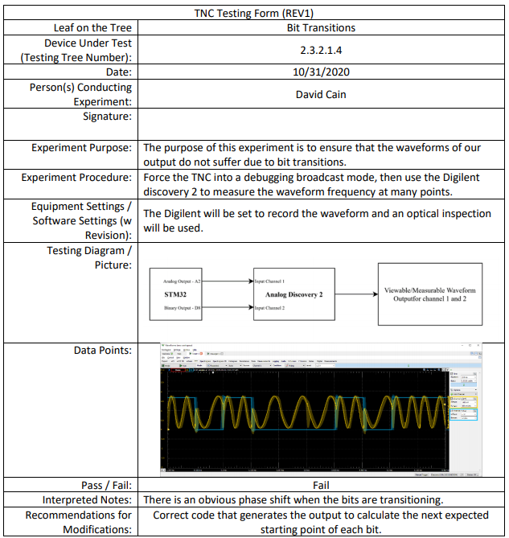

Slide 10
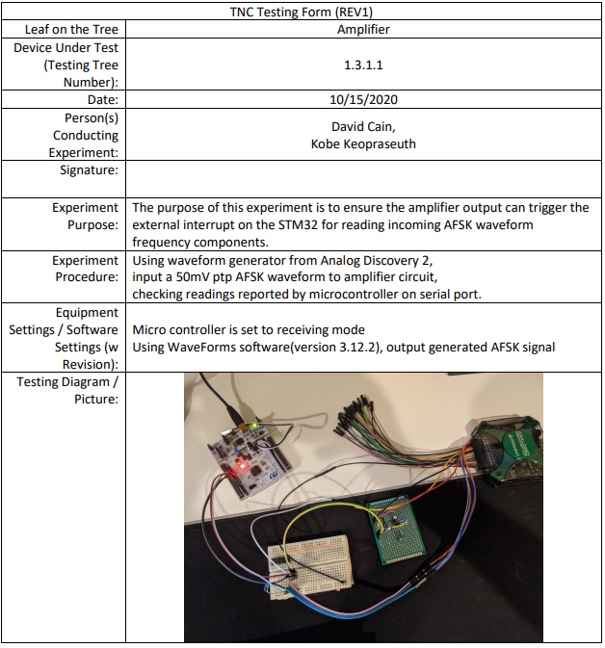
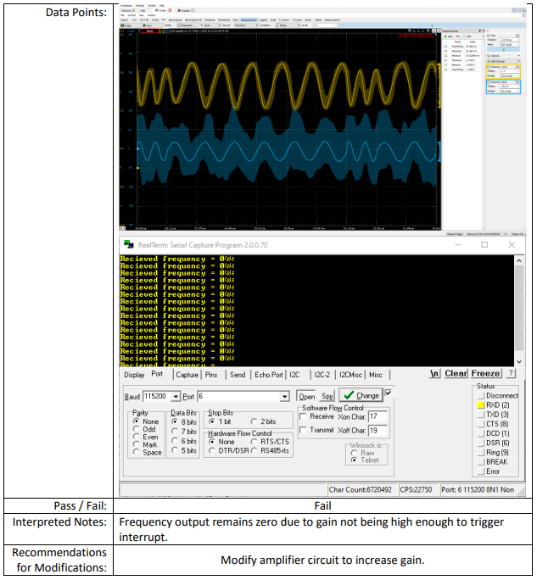

Slide 12
Changes Made to Testing Plan
Removing Audio Input Circuit (1.3)
Amplifier (1.3.1) also removed
LP Filter (1.3.2) also removed
Testing clock recovery and data decoding with new board provided by the mentors
Removed RS232 Jack (1.1.1.3)
Removed Validation (2.2.2.1) under packet construction because it was redundant

Slide 13
Change Order Forms

Slide 14
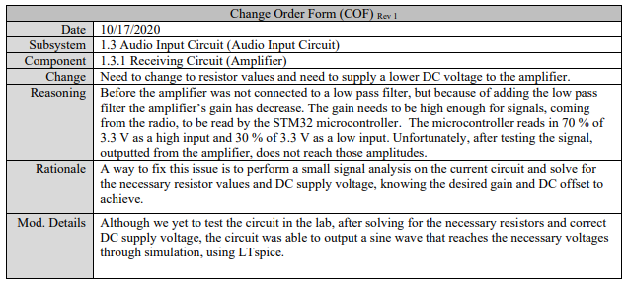

Slide 15
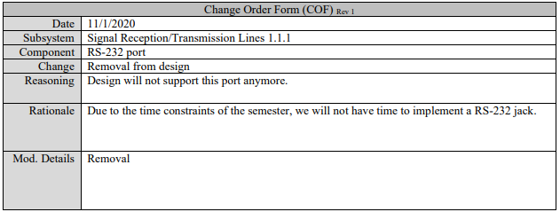

Slide 16
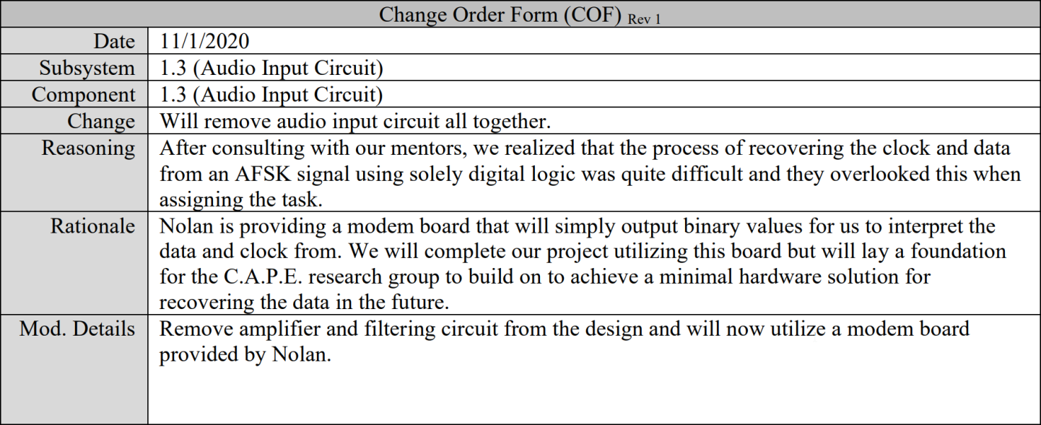

Slide 17
Tests to be done by Project End
Analog to Digital Conversion aka Receiving
Needs additional tweaking to have initial functionality
Audio tone RX and TX full subsystem test
Full software test
Micro Controller functionality testing
Power Consumption (1.1.2.1) in Signal Processing
Audio Jack (1.1.1.2) in transmission lines
Full Final Design Testing Coming soon

Slide 18
Questions?

